Slide 1
Homeschool HOPE Requirements
K-12 Outreach
Hal Wilkinson
2023-2024

Slide 2
Graduates of an Ineligible High School or Unaccredited Home Study Program or Earned a High School Equivalency diploma (HSE)
HOPE Scholarship Academic Eligibility Requirements as an entering freshman at an eligible college or university in Georgia (after high school graduation or home study completion) or earned an HSE diploma from a TCSG institution.

Slide 3
Initial Academic Eligibility
Meet the following criteria:
1. Graduate from an ineligible high school or complete an unaccredited home study program or earn an HSE.
2. Earn a qualifying test score on a single national or state/district administration of the ACT or single national administration of the SAT prior to high school graduation or home study / HSE diploma completion. An initial academic eligibility determination is based on the single highest qualifying score received and recorded in GSFC’s system.
A minimum composite score of 24 is required for the ACT.
A minimum score of 1160 is required for the SAT.

Slide 4
Initial Academic Eligibility Process
After graduation from an ineligible high school or completion of an unaccredited home study program or HSE, if you believe you meet the HOPE Scholarship ACT or SAT score requirement as listed above, your eligibility must be evaluated manually.
Follow the instructions on the Unaccredited Home Study Programs or HSE diploma state program request form and submit all of the required documents through the Student Document Upload.

Slide 5
Retroactive Academic Eligibility
Students who graduated from an ineligible high school or completed an unaccredited home study program but were not initially academically eligible may receive the HOPE Scholarship retroactively if they earn a 3.0 postsecondary calculated HOPE GPA after attempting 30 semester or 45 quarter hours of college degree-level credit. Credit hours earned by examination or coursework taken prior to high school graduation or home study completion cannot be used to gain HOPE Scholarship eligibility.
Meet the following criteria:
1. Attempt 30 semester or 45 quarter hours of college degree-level credit after high school graduation or home study completion and
2. Earn a minimum 3.0 postsecondary calculated HOPE GPA

Slide 6
Retroactive Academic Eligibility Process
If you graduated from an ineligible high school or completed an unaccredited home study program and believe you meet the HOPE Scholarship GPA requirement after attempting 30 semester or 45 quarter hours, your eligibility must be evaluated manually.
Sign in to your GAfutures account to access My College HOPE Profile and verify your Checkpoint History prior to requesting retroactive academic evaluation. Follow the instructions on the Unaccredited Home Study Programs or HSE diploma state program request form and submit all of the required documents through the Student Document Upload.

Slide 7
Retroactive Academic Evaluation and Application Deadline
Retroactive evaluation requests should be submitted by the last day of the semester or quarter immediately following the semester or quarter in which you reached the 30 semester or 45 quarter attempted-hour checkpoint (excluding summer semester).
The FAFSA or GSFAPP application deadline for HOPE Scholarship retroactive payment is the last day of the semester or quarter immediately following the semester or quarter in which you reached the 30 semester or 45 quarter attempted-hour point (excluding summer semester)
*Students must meet all program eligibility requirements.

Slide 8
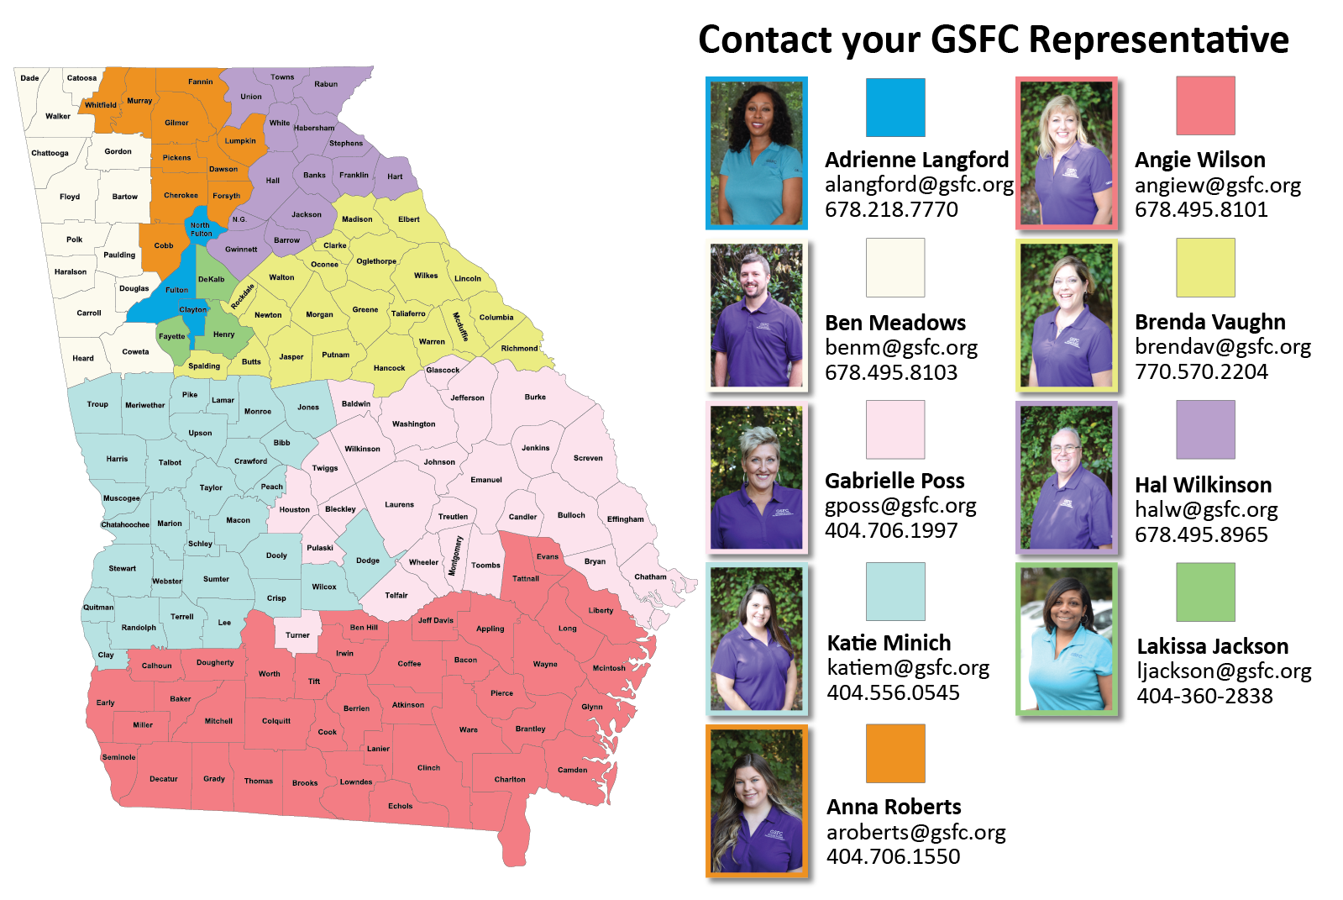
OUTREACH TEAM
GSFC Representative Map
Notes:
While you are completing the survey, I want to show you our territory map. Each student, parent, and institution has an outreach representative. Let us help you plan, apply, and pay for college.
Click

Slide 9
State Aid/HOPE Program
Hal J. Wilkinson
K12 Outreach Staff
Email: halw@gsfc.org
Phone: 678-495-8965

Slide 10
HOPE Program
General Eligibility Requirements
Be a legal resident of Georgia
Be registered with the Selective Service, if required
Be in compliance with the Georgia Drug-Free Postsecondary Education Act of 1990
Meet U.S. citizenship or eligible non-citizen requirements
Be in good standing on all student loans and other financial aid programs
Attend an eligible postsecondary institution
Must be working toward the first undergraduate program
Notes:
These are the general eligibility requirements for the HOPE Program. I’d like to point out two of the requirements.
Click

Slide 11
HOPE Scholarship
HOPE Program
HOPE
Scholarship
Zell Miller
Scholarship
HOPE
Grant
Zell Miller
Grant
HOPE GED
Grant
HOPE Career Grant
Notes:
Next, lets talk about the eligibility requirements for the HOPE Scholarship.
Click

Slide 12
HOPE Scholarship Eligibility Requirements
Students must pursue an associate or bachelor’s degree
Graduate with a 3.0 high school HOPE GPA
After high school graduation, may also be earned in college
4 academically rigorous course credits
Notes:
First, the HOPE Scholarship is awarded to students pursuing an associates or bachelors degree.
Students must graduate with a 3.0 high school HOPE GPA from a Georgia high school, and 4 academically rigorous course credits.
For home school students, the requirements differ. For more information, contact us.
Click

Slide 13
Academically Rigorous Courses
Courses must be on Academic Rigor Course List. This includes:
Advanced Placement (AP)
International Baccalaureate (IB)
Dual Enrollment in degree level core subjects
Advanced math
Advanced science
Foreign language II or higher
Notes:
Rigor credits can be earned by taking AP, IB, or Dual Enrollment core courses.
Rigor credits can also be earned from advanced courses. For example, Anatomy and Physiology, Chemistry, Biology 2, Pre-Calculus, Algebra 2, and a second or third year of a foreign language, are all considered rigor courses.
If unsure about a course and whether it is considered academically rigorous, visit GAfutures.org to select the tab for HOPE and State Aid Programs or, for quicker access simply utilize the GAfutures webinar documents link that was provided.
Click

Slide 14
Maintaining the HOPE Scholarship
Students must maintain 3.0 college HOPE GPA at all checkpoints including:
End of every Spring semester/quarter
30/45 attempted semester/quarter hours
60/90 attempted semester/quarter hours
90/135 attempted semester/quarter hours
Three-Term Checkpoint, if enrolled less than full time for first three semesters/quarters
Notes:
To maintain the HOPE Scholarship while in college, a student must maintain at least a 3.0 college HOPE GPA at all checkpoints including every spring term of enrollment.
Click

Slide 15
Zell Miller Eligibility Requirements
Rigor Requirements and one of the following:
Designated valedictorian or salutatorian AND Meet minimum HOPE eligibility requirements |  |  | Minimum 3.7 high school HOPE GPA, as calculated by GSFC, in core curriculum courses AND 1200 SAT total test score OR .25 ACT composite test score. .
Notes:
To receive the Zell Miller Scholarship, a student must meet the general eligibility requirements of the HOPE Program, as well as the following:
If the student is designated as the valedictorian or salutatorian, they are eligible to receive the Zell Miller Scholarship.
All other students, must graduate with:
a 3.7 high school HOPE GPA,
4 rigor course credits and
a 1200 on the SAT OR a 26 on the ACT
Students can take the tests multiple times and use the highest score. The test scores must be earned in one sitting and taken prior to graduation.
Click

Slide 16
Student Document Upload
Students may upload documents for State Financial Aid Programs
SAT test score reports may be uploaded
Directions for SAT:
Print test score report from College Board
Student must sign, date, and write this statement on report: “This is a true and exact copy of the original score report.”
Sign into GAfutures account and select Document Upload, on left side of page.
Select Document type: SAT Scores
Attach document file and select submit

Slide 17
Submitting ACT Scores for Zell Miller
Steps for submitting ACT scores:
Go to ACT.org and sign into student account
Select ACT score report be sent to GSFC by entering recipient code: 2225
ACT will then send GSFC and electronic file to update student’s record.

Slide 18
Maintaining the Zell Miller Scholarship
Students must maintain 3.3 college HOPE GPA at following checkpoints:
End of every Spring semester/quarter
30/45 attempted semester/quarter hours
60/90 attempted semester/quarter hours
90/135 attempted semester/quarter hours
Three-Term Checkpoint, if enrolled less than full time for first three semesters/quarters
Notes:
Maintaining the Zell Miller Scholarship is similar to the HOPE. The checkpoints are the same, but a student must have at least a 3.3 college HOPE GPA.
Click

Slide 19
HOPE & Zell Miller Scholarships
Students lose eligibility due to one of the following:
GPA requirement not met (3.0 for HOPE; 3.3 for Zell Miller)
Reaching maximum attempted hours
127 semester
190 quarter
Failing to use funds within ten years of high school graduation or equivalent
Exception for active duty military service in United States Armed Forces
Received bachelor’s or first professional degree
Notes:
There are a few ways students can lose their eligibility for the HOPE Scholarship and Zell Miller Scholarship:
Not maintaining your GPA
Reaching the maximum hours allowed
Failing to use your award within seven years
and receiving a bachelor’s or professional degree.

Slide 20
HOPE Grant
Eligibility Requirements:
Enrolled in certificate or diploma program
High school diploma/GED not required
High school GPA and/or test scores not considered
Notes:
Like all components of the HOPE Program, the general eligibility requirements will also apply to the grants.
Yet, what’s different is that grants can only be used for students who are enrolled in a certificate or diploma program.
Also, there is no high school HOPE GPA requirement, and test scores are not considered.
Click

Slide 21
Maintaining the HOPE Grant
Students must maintain a 2.0 college cumulative GPA at the following checkpoints:
30 HOPE Grant paid semester hours
60 HOPE Grant paid semester credit hours
Maximum 63 paid semester hours
Notes:
To maintain the HOPE Grant, Terri must have a 2.0 college cumulative GPA at the checkpoints.
Click

Slide 22
Zell Miller Grant
Eligibility Requirements:
Minimum 3.5 college cumulative GPA
Checkpoints occur at the end of every term of enrollment
Must be a HOPE Grant recipient initially
May be paid retroactively for first term
Maximum 63 combined paid hours Zell Miller and HOPE Grants
Notes:
To keep the Zell Miller Grant, must maintain at least a 3.5 college cumulative GPA every term.
Not eligible for Zell Miller Grant until one semester is completed because would have to have at least a 3.5 college cumulative GPA.
Click

Slide 23
Award Amounts
 | HOPE Scholarship | Zell Miller Scholarship
Public Institutions | portion of tuition | full standard tuition
Private Institutions Full-time | $2,496 per semester (fall, spring, summer) $1,664 per quarter (fall, winter, spring, summer) | $2,985 per semester (fall, spring, summer) $2985 per quarter (fall, winter, spring, summer)
 | HOPE Grant | Zell Miller Grant
Public Institutions | portion of tuition | full standard tuition
Notes:
At public institutions, the HOPE Scholarship and Grant cover a portion of the tuition. Tuition rates can vary at each institution.
The Zell Miller Scholarship and Grant provide full tuition at our public institutions.
Neither award can be used for books, housing, meal plans, or fees. Only tuition.
Students can receive the HOPE or Zell Miller Scholarship at private institutions; it is a set amount per term of enrollment.
Students do not have to be enrolled full-time for these grants and scholarships. However, the awards are capped at 15 credit hours. This also applies to courses taken in the summer.
Click

Slide 24
HOPE Scholarship Change

Slide 25
HOPE/Zell Miller Scholarship Updates
HOPE Scholarship and Grant at TCSG and USG Institutions
New – HOPE Award Rate set the award amount for all eligible public institutions to 100% of the prior year (FY 2023) standard undergraduate tuition rate
TCSG’s standard tuition rate remains at $100 per credit hour
HOPE Scholarship and Grant will pay $100 per hour
Zell Miller Scholarship & Grant will pay $100 per hour
USG’s Board of Regents has not set the standard undergraduate rates for their institutions yet
Award Charts will be made available once all info is available
The scholarships award amounts have increased for private institutions in Georgia (2023-2024 Award Year):
HOPE Scholarship award amount is 2,496 per semester (12-15 semester hours)
Zell Miller award amount is 2,985 per semester (12-15 semester hours)

Slide 26
Tuition Equalization Grant
Tuition Equalization Grant Regulations
New – Award amounts
Award rate increases
Per semester increase from $500 to $550
Per quarter increase from $333 to $366/$366/$367 (per term)

Slide 27
HOPE and Zell Miller Grant
HOPE Career Grant in the HOPE Grant and Zell Miller Grant Regulations
Revision of award rates
Award rate for Basic Law Enforcement and Basic POST Certification certificate programs
Maximum award amount increase from $3,500 to $3,750
Award rate for Commercial Truck Driving certificate programs
Maximum award amount increase from $1,000 to $1,100

Slide 28
HOPE Career Grant
HOPE Grant and Zell Miller Grant recipients eligible for HOPE Career Grant
Movie Production and Set Design
Computer Programming
Computer Technology
Practical Nursing
Early Childhood Care and Education
Welding and Joining Technology
Precision Manufacturing
Certified Engineer Technician
Commercial Truck Driving
Health Sciences
Diesel Equipment Technology
Industrial Maintenance Technology
Automotive
Aviation
Construction
Electrical Line Worker
Logistics
Notes:
The HOPE Career Grant has become a great financial resource for many students.
Students receiving the HOPE Grant or the Zell Miller Grant may also be eligible for additional financial assistance from this program.
This program was created to boost enrollment in high-demand certificate and diploma programs such as Commercial Trucking, Early Childhood Care/Education and Practical Nursing.
There are 17 in-demand career fields with more than 300 approved certificate and diploma programs eligible for the HOPE Career Grant.
Five new fields were added in FY 2018: Construction, Aviation, Electrical Line Work, Logistics and Automotive Technology.
The award is a fixed amount depending on the program and number of hours the student is enrolled.
You can find a list of approved programs and award amounts at GAfutures.org
This program is not available for dual enrollment students.

Slide 29
HOPE Career Grant
Enrolled Semester Hours | Award Amounts
1-2 hours | $125
3-8 hours | $250
9+ hours | $500
9+ hours | $1,100 award per truck driving program
Notes:
The HOPE Career Grant is a set amount which is based on two factors: the number of credit hours within the term of enrollment AND the program of study.
Just a side note, a student could have full standard tuition paid with the combination of the HOPE Grant and the HOPE Career Grant.
Click

Slide 30
Scholarships
Scholarship examples:
Height
Ethnicity
Religious affiliation
Gender
Being a multiple (twin, triplet, etc.)
Left-handed
Video on social media
Notes:
It is always best to first utilize money that doesn’t have to be repaid such as scholarship and grants.
A scholarship is a type of financial aid that is typically awarded based on a student’s GPA and/or test scores. But don’t let that limit the search. Many can be found based on a variety of criteria.
Most grants on the other hand are need-based, which means they are usually awarded to student’s with high financial need. We will talk more about need-based aid later.

Slide 31
Duct Tape Scholarship
To enter the Duct Tape Scholarship, you and your partner must be legal residents and at least 14 years old. Either opposite sex or same sex partners may participate. You must attend a high school prom and have your photo taken before, during or after the prom in your attire made using duct tape.
Costumes must be original and will be judged based on workmanship, originality, use of color, use of accessories, and use of duct tape.
Photos of the 10 finalist couples will be posted online for online voting.
For more information about the Duct Tape Scholarship Contest see, duckbrand.com

Slide 32
Tuition Assistance
Bank of America
Dollar General
Chilis
United Postal Service
QT ( Gas Station)
Racetrac
Kroger's
Publix
Sprouts
Wells Fargo
TGI Fridays

Slide 33
Job Opportunities & Scholarships
- offers scholarships of $2000/term
- - offers $1600 tuition reimbursement
- offers $1,000 scholarships

Slide 34
Scholarship Search
Notes:
The Scholarship Search uses a national database that can be searched by key word or you can use various filters to help narrow down your search.

Slide 35
Additional Scholarship Resources
www.fastweb.com
www.collegeboard.com
www.finaid.org/scholarships
UNIGO.COM

Slide 37
FAFSA Updates/Reminders
The 2025-2026 FAFSA (Free Application for Federal Student Aid) opens December 1st , 2024.
New – Selective Service Registration is no longer a requirement for Federal Student Aid.
Please note Selective Service is still a requirement for State Aid.
It is recommended that FSA IDs are created at least 10 days before the student starts to complete the FAFSA.

Slide 38
2025-26 FAFSA Simplification
Parents without SSN, will have to create an FSA ID.
Individuals without a social security number will be able to create an FSA ID.
The signature page will no longer be available. Student will need to print the Summary Page.
No more DRT, so students nor parents will be able to see OR change IRS data.
All parents who have a tax return will need an FSA ID.
Married – File Jointly: one (1) FSA ID
Married – File Separately: two (2) FSA IDs

Slide 39
2023-24 FAFSA Simplification
EFC, now Student Aid Index (SAI)
Pell Grant increased to $7,395
FAFSA can open anytime between Dec. 1st, 2024

